Slide 1
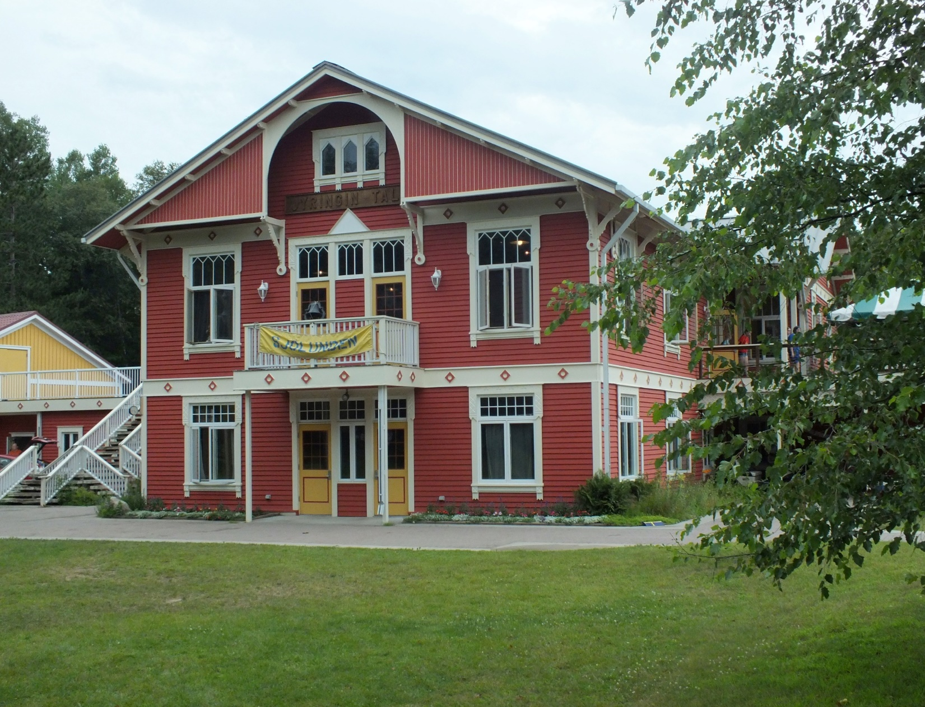
Bemidji, Minnesota
Sjölunden: Swedish Immersion

Slide 2
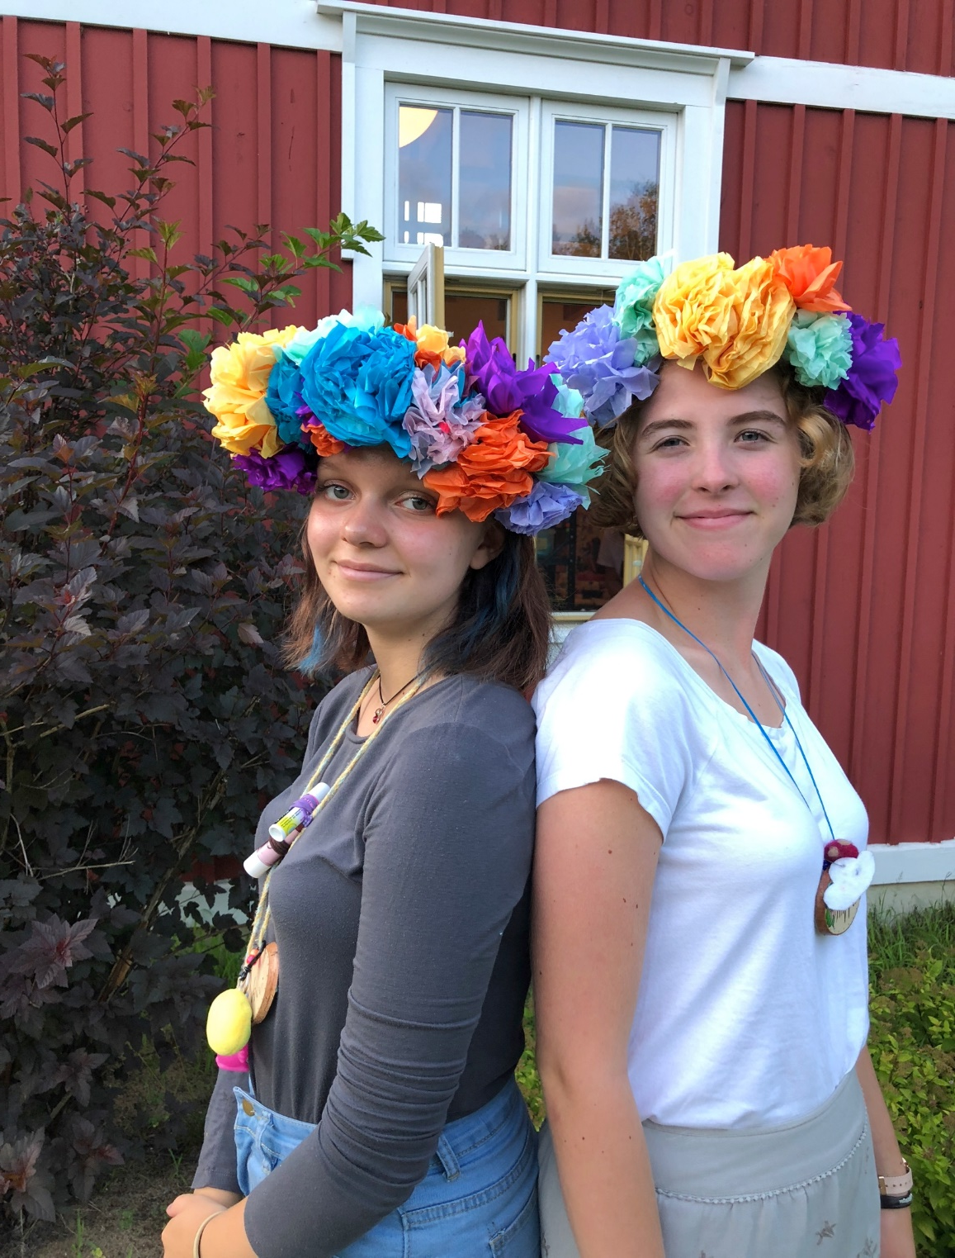
My name is Claire (the one on the right.) I was fortunate enough to be a recipient of the Concordia Summer Camp Scholarship this year and have been able to attend Sjölunden for four years. I have met life-long friends from all over the country and Sweden. Here is a taste of what I got to be a part of at the Swedish immersion camp.

Slide 3
Here is our high school credit student group on an outing in Bemidji.

Slide 4
Sjölunden is an immersion experience where the counselors will only speak Swedish. This is an example of them using contextual learning to help campers learn.

Slide 5
These types of signs are used all over the camp to help us visually learn about the language and are frequently repeated throughout the day.

Slide 6
We take part in enjoying a traditional feast as part of the Misdsommar celebration.
During Midsommar, they teach us traditional Swedish dancing. We cut flowers and raise our newly created Maypole.

Slide 7
I had the opportunity to be Santa Lucia for our Jul celebration. All of the credit students wearing white, hold candles, and sing traditional Swedish Jul songs as a processional through the cabins.

Slide 8
An example of dalmålning, a traditional detailed Swedish painting technique.
Campers are taught how to use the loom and able to make their own textiles. I made a small rug.
There are lots of different art classes that can be taken. I’m shown here painting fabric that can be framed.

Slide 9
Our small class groups meet every day to learn the language in a more formal setting which includes grammar and sentence structure.

Slide 10
Traditional music is a large part of the exposure to Swedish culture.
We also use music to help us learn songs that increase our vocabulary. We always participate. It is the only way to learn.

Slide 11
At the end of our experience, we had Studenten, the Swedish high school graduation ceremony.
We wore white and made our own student caps just like they do in Sweden. There was a huge feast and we talked about how this learning experience has affected us.

Slide 12
This camp experience has been amazing. It has taught me that I can be a part of Swedish culture. My goal is to someday study abroad and really get to live like a Swede.

